Slide 1

Module 2-Big Data Algorithms
Page Ranking and relational Algebra

Slide 2

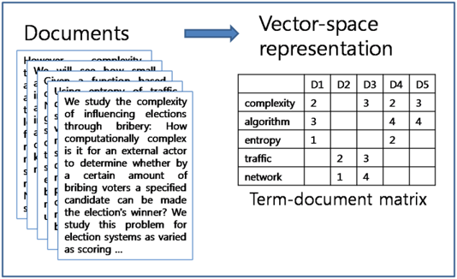
BIG DATA ALGORITHMS
Working of Traditional Page Rank
Page1
Links to
Page 2
Page 3
Search for a term e.g “Big Data
Page 2
Links to
Page 1
Page 3
Page 4
Importance computation based on usage of terms within the page.
Page 3
Links to
Page 4
Page 1
Lookup an inverted index: maps every word to documents that contain the term
Page 4
Links to
Page 1
Page 2
Sort matched pages based on importance
Pages in the WWW

Slide 3


BIG DATA ALGORITHMS
Issues with Conventional Approach

Slide 4
BIG DATA ALGORITHMS
How to resolve it?
While searching for the term how
Many are clicking on me

Slide 5
BIG DATA ALGORITHMS
How Google made the search Engine?
Two techniques
Consider random surfers starting at a random pages
What fraction of surfers end up at my page?
This gives an indication of the importance of my page.
Page Rank
Take into account the terms near the links present in pages that point to my page
Gives an indication of how relevant my page is.

Slide 6
Page Rank Algorithm Working
Notes:
Exercise
Write a similar program for
Finding the words in a file
For each word, calculate the count
Assume the file contains the string
“To be or not to be”
Hint
This should be done in parallel
In the blue boxes, read in each line in the file
If the line is w1 w2 w3 w4, then output 4 lines w1 1 w2 1 w3 1 w4 1

Slide 7
BIG DATA
Adjacency Matrix
1
2
0 1 1 1
1 0 0 1
1 1 0 0
0 1 1 0
3
4
Let us start from our graph model of the internet
- Adjacency matrix represents which pages are reachable from a given page

Slide 8
BIG DATA
Adjacency Matrix
If we are at node 4 (page 4) and we follow a link out
Then
- the pages we can visit are 1 and 2
- 3 is not reachable directly from 4
To summarize for node 4
#in links = 2
#out links = 2
1
2
3
4

Slide 9
BIG DATA
Random surfer
1
2
Consider, a random surfer starting from page 4
Assume, that we have equal probability of taking either out link
So,
P(transition at node 4) = 1/#outlinks
= ½
3
4

Slide 10
BIG DATA
Transitioning at a node
1
2
For node for we can represent the probabilities of directly transitioning
To every other page as a column vector
Source
3
4
Dest
1/2
1/2
0
0

Slide 11
BIG DATA
Transition Matrix
1
2
For the entire graph with n nodes, this would be a nxn matrix
Transition matrix (M)
Each entry represents the probability of transition from a source to a destination
Source → column #
Destination → row #
3
4
Source
Dest
0 1/3 1/2 1/2
1/2 0 0 1/2
1/2 1/3 0 0
0 1/3 1/2 0

Slide 12
Page Rank : Following the random surfer
Notes:
Exercise
Write a similar program for
Finding the words in a file
For each word, calculate the count
Assume the file contains the string
“To be or not to be”
Hint
This should be done in parallel
In the blue boxes, read in each line in the file
If the line is w1 w2 w3 w4, then output 4 lines w1 1 w2 1 w3 1 w4 1

Slide 13
BIG DATA
Random surfer - initialization
1
2
The random surfer can start off on any of the nodes
So each node has equal chance of being a starting node.
Lets call the relative importance of each node -→ importance represented as vector v
Our first guess at this is called v₀
v₀ ₌
3
4
1/4
1/4
1/4 1/4
Node importance

Slide 14
BIG DATA
Random surfer - movement
1
2
As random surfer moves once
Compute chance they will land up in each of the nodes
For each node we compute the probability of ending up at that node based on previous node
Multiply transition matrix and v
3
4
v₀
v₁
0 1/3 1/2 1/2
1/2 0 0 1/2
1/2 1/3 0 0
0 1/3 1/2 0
1/4
1/4
1/4 1/4
1/3*1/4+1/2*1/4+1/2*1/4
½*1/4+1/2*1/4
½*1/4+1/3*1/4
1/3*1/4+1/2*1/4
1/3
1/4
5/24 5/24
=
=

Slide 15
BIG DATA
Random surfer - movement
1
2
With each move of the random surfer, we will repeat the computation
Multiply transition matrix and v
3
4
v₁
0 1/3 1/2 1/2
1/2 0 0 1/2
1/2 1/3 0 0
0 1/3 1/2 0
1/3
1/4
5/24 5/24
=
v₂

Slide 16
Page Rank : As an Eigen vector problem
Notes:
Exercise
Write a similar program for
Finding the words in a file
For each word, calculate the count
Assume the file contains the string
“To be or not to be”
Hint
This should be done in parallel
In the blue boxes, read in each line in the file
If the line is w1 w2 w3 w4, then output 4 lines w1 1 w2 1 w3 1 w4 1

Slide 17
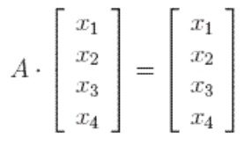
BIG DATA
Iterative Algorithms
x satisfies the equation to the right.
Generally: some set of equations for x.
How do we solve for x?
Iterative algorithm: widely used in Big Data
i = number of times we have looped,
x_{i} = value of x on i^{th} iteration,
Calculate some “error term” based upon x_{i} .
Shows how far x_{i} is from the correct value.
E.g., Ax_{i} - x_{i}
Derive x_{i+1} based upon x_{i} and error term.
Loop over steps 3 and 4 until error term is small.
Iterative algorithm calculates x₀ x₁ x₂ x₃ … which eventually converges to a good (or the good) solution.

Slide 18
BIG DATA
Iterative Algorithms: Fixed Point Iteration
Suppose the equation that x satisfies has the form x=f(x)
x may be a matrix or vector, then the following simplified iterative algorithm frequently works
Fixed point iteration
Initialize x₀ to some value
Calculate x_{i+1} = f(x_{i})
Loop over step 2 until either
error term = |x_{i+1}-x_{i}| is small i.e., not much change between x_{i+1} and x_{i}
or for some maximum number of iterations.
https://en.wikipedia.org/wiki/Fixed-point_iteration#:~:text=In%20numerical%20analysis%2C%20fixed%2Dpoint,the%20fixed%20point%20iteration%20is

Slide 19
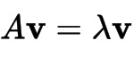
BIG DATA
Eigenvalues and eigenvectors
Multiplying a mxn matrix by an n element vector gives an m element vector.
If matrix is nxn, the product will also be an n element vector.
Suppose
Multiplying A by v gives back the same vector apart from a scale change .
is called the eigenvalue and v the eigenvector.
Many problems (e.g., page rank) can be converted into finding eigenvalues of a matrix.

Slide 20
BIG DATA
Page Rank as Eigenvector Problem – Eigenvector Computation
Initialize v to be a vector of equal values.
Loop
v_{i+1} = Av_{i}
Until there is little difference between v_{i} and v_{i+1}
At this point
V = Av
v is the eigenvector and page rank of the transition matrix of the web graph.

Slide 21
BIG DATA
Page Rank as Eigenvector Problem – Overview
We want to compute the importance (page rank) of each Web page.
Assume that
If a page has importance l.
n links to other pages
It distributes it's importance I among the n links equally (I/n)
Use this assumption to calculate page rank

Slide 22
Page Rank : Map Reduce Implementation
Notes:
Exercise
Write a similar program for
Finding the words in a file
For each word, calculate the count
Assume the file contains the string
“To be or not to be”
Hint
This should be done in parallel
In the blue boxes, read in each line in the file
If the line is w1 w2 w3 w4, then output 4 lines w1 1 w2 1 w3 1 w4 1

Slide 23
BIG DATA
Implementation in Map Reduce
We need support for
Handling multiple files as input to the mapper
The initial page rank
Part of the Transition Matrix
Iteration over multiple matrix-vector multiplication rounds

Slide 24
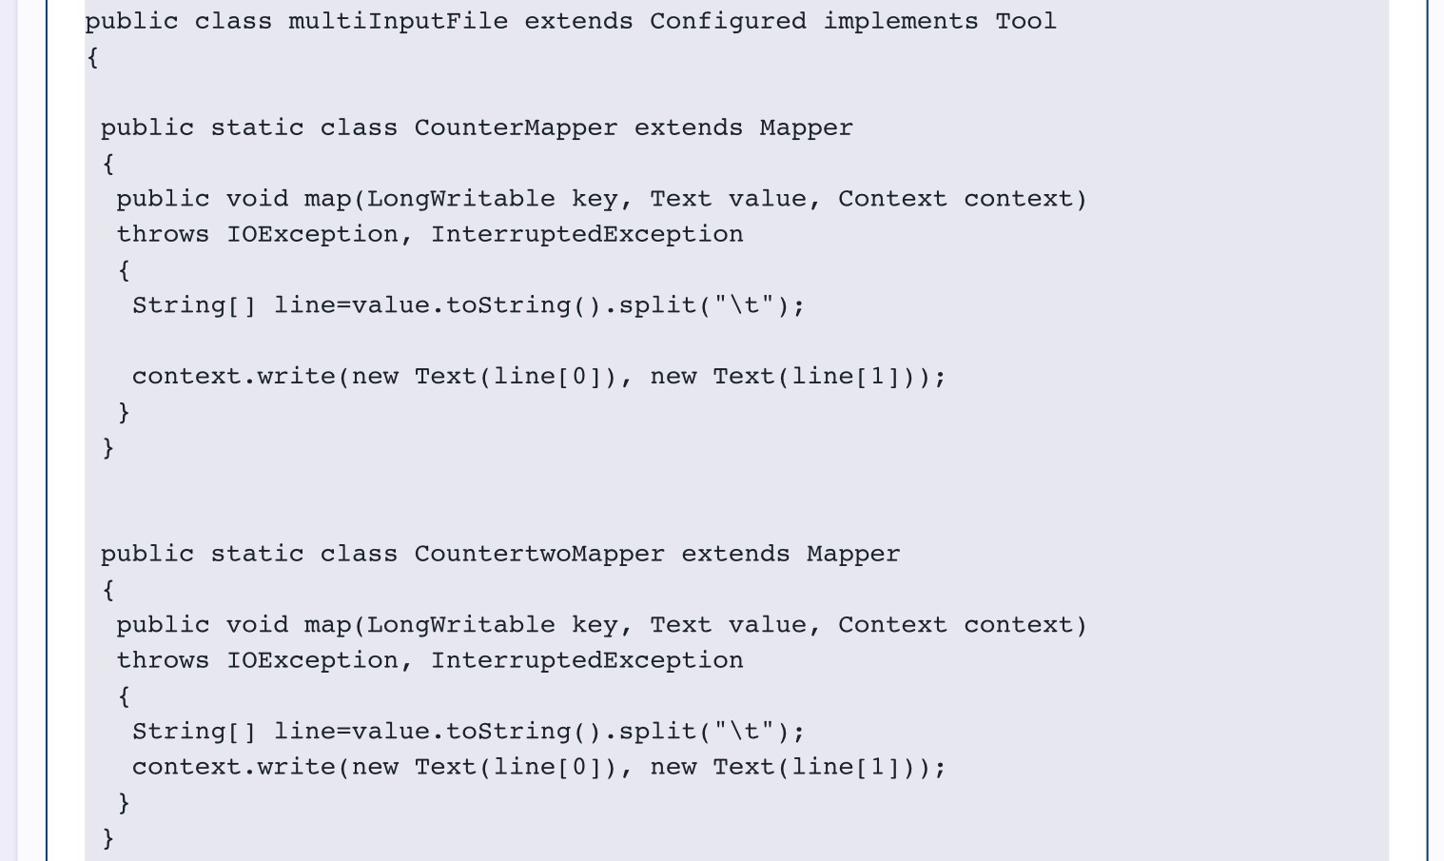
Hadoop Multiple Input Files – mapper
BIG DATA
Mappers write first word as key, 2nd word as value

Slide 25
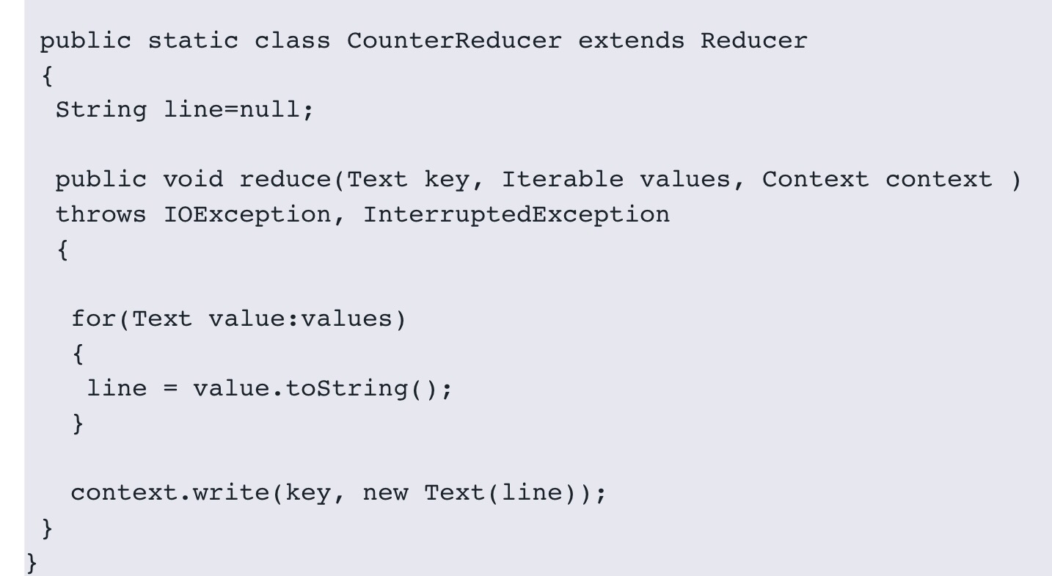
Hadoop Multiple Input Files – reducer
BIG DATA
Loop over values
Write each value as separate record

Slide 26
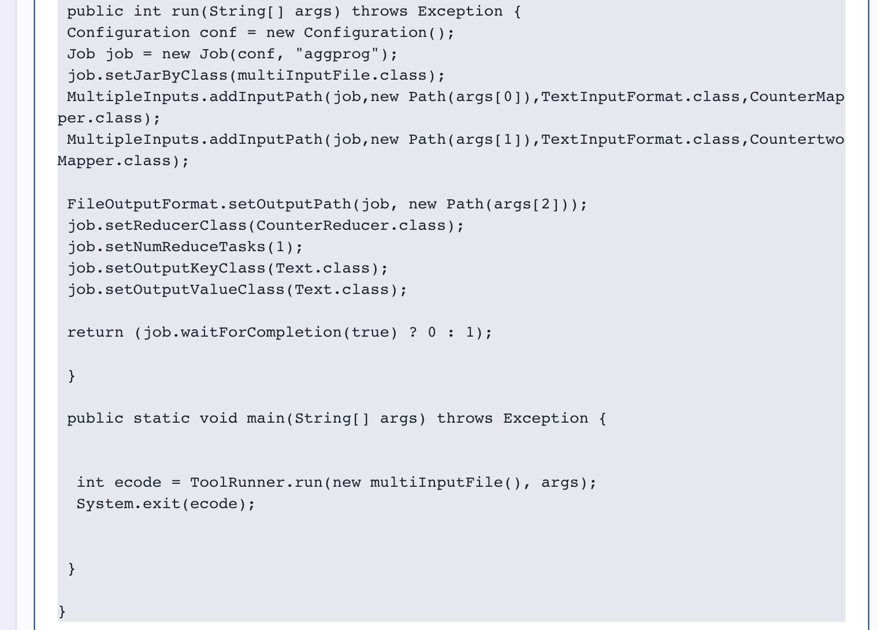
Hadoop Multiple Input Files – job
BIG DATA
Multiple input class
Set input file for each mapper

Slide 27
BIG DATA
Iteration
One MR step produces a estimate of v
The file is stored in HDFS
At the end of the iteration, we need to compare this with the previous iteration estimate of v
After that, we use this file as the input for the next step of MR.

Slide 28
THANK YOU

